Slide 1

Big Data Analysis
Team 5

Slide 2

Vaccine hesitancy
The delay or refusal to vaccinate despite readily available supplies and services is known as vaccine hesitancy, and healthcare providers worldwide continue to see it as a widespread public health issue Acknowledgment of novel Coronavirus antibodies supports the possible outcome of current worldwide vaccination crusades. Because of their influential position as reliable sources for vaccination, healthcare providers' vaccine hesitancy may jeopardize this success.

Slide 3

Methodology
This study was conducted between 25th and 30th June 2021, across 23 nations. 23,000 adult respondents were surveyed, 3,295 of which identified as healthcare providers. Recruiting methods included telephone, direct mail and email, with layers of segment factors requiring at least 50 members. The results were weighted to ensure representativeness of the nation across age, orientation, and training level.

Slide 4
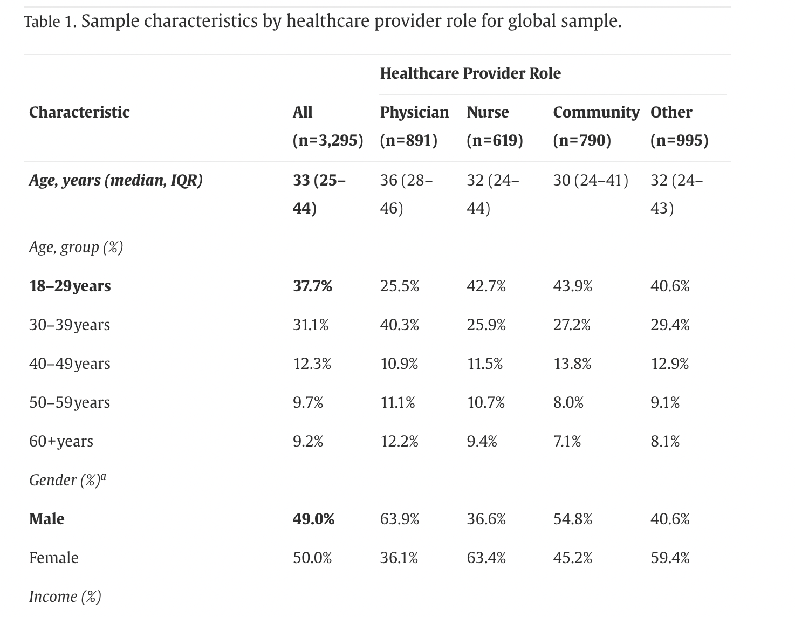
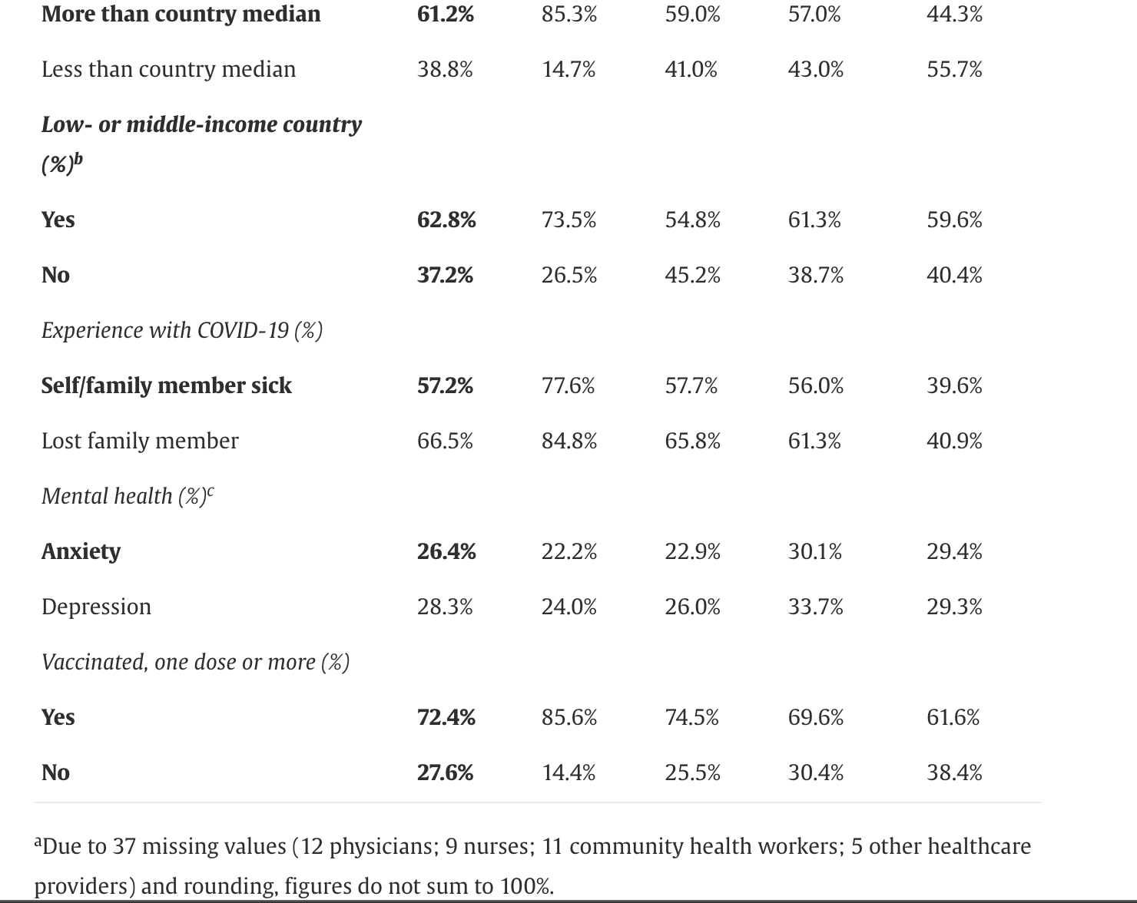

Slide 5
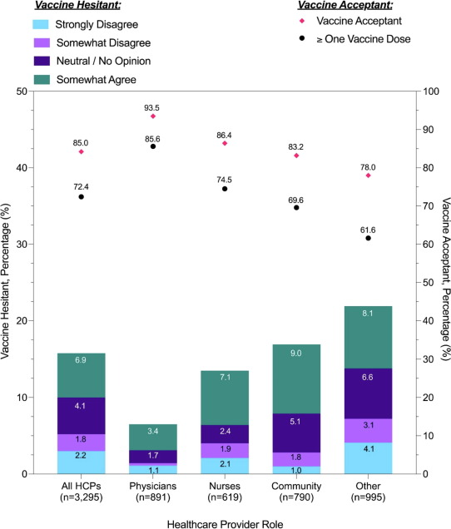
Vaccine Hesitance and acceptance by healthcare provider role

Slide 6
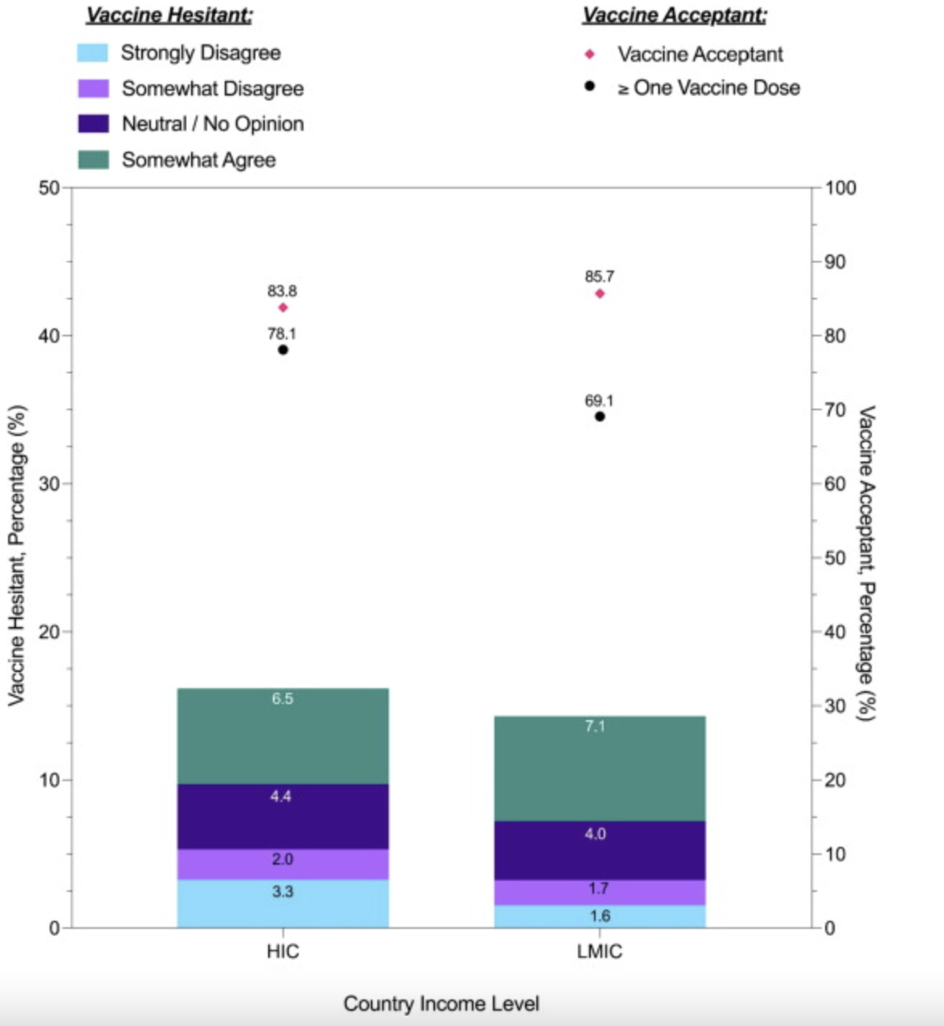
Vaccine Hesitance and acceptance by country income

Slide 7

Develop evidence-based communication-
This strategies using the analysis to effectively communicate vaccine information, address misinformation, and promote vaccination.

Slide 8

Key Messages
Effective communication about COVID-19 requires clear, concise, and consistent messaging that is based on the latest scientific evidence.
Key messages should emphasize the importance of taking preventive measures such as wearing masks, washing hands regularly, and maintaining physical distance from others.

Slide 9


Delivery Channels
To reach a wide audience, it is important to use a variety of delivery channels, including traditional media (TV, radio, newspapers), social media, and community outreach programs.
Messages should be tailored to the specific needs and preferences of different audiences, such as older adults, children, and people with disabilities.

Slide 10

Audience Segmentation
Effective communication about COVID-19 requires a deep understanding of the target audience, including their beliefs, attitudes, and behaviors.
Segmenting the audience based on demographic factors such as age, gender, and ethnicity can help tailor messages to their specific needs and preferences.

Slide 11

Evaluation
To ensure that communication efforts are effective, it is important to regularly evaluate the impact of messaging on target audiences.
Evaluation methods may include surveys, focus groups, and social media analytics, and should be used to refine messaging and delivery strategies over time.

Slide 12
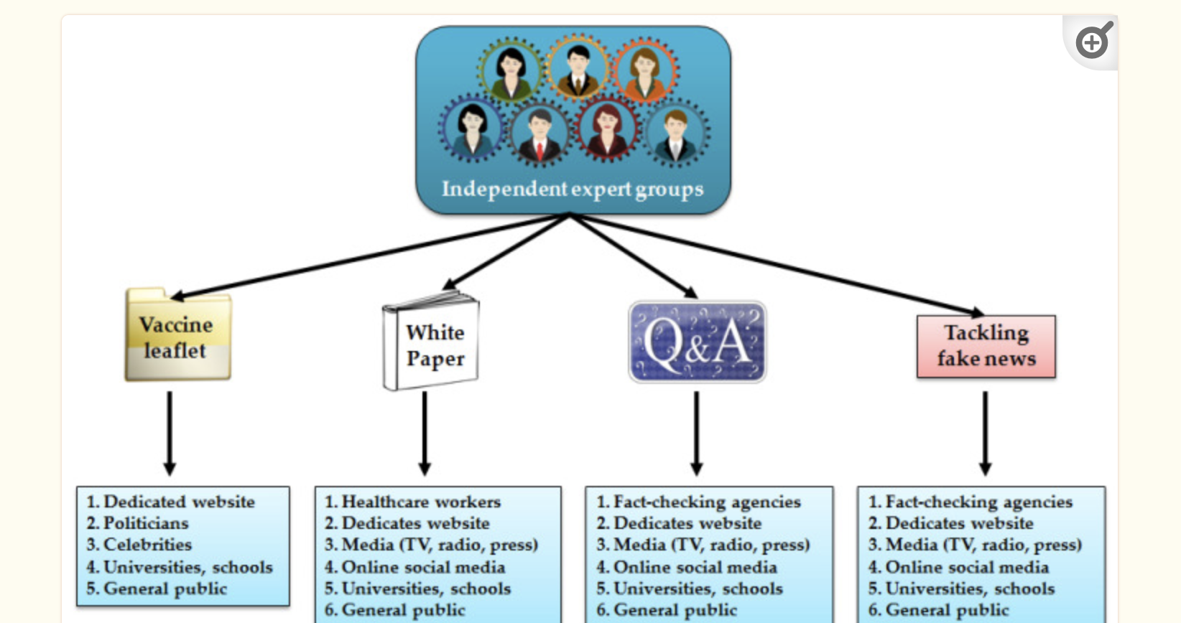

Slide 13

Conclusion
Effective communication about COVID-19 requires a comprehensive, evidence-based approach that takes into account key messages, delivery channels, audience segmentation, and ongoing evaluation.
By using these strategies, we can help people understand the risks of COVID-19 and take appropriate actions to protect themselves and others.

